Slide 1
Statement
A factory packs dehydrated fruits to be sold in stores. The raw materials used are: figs, pineapple, dates, cranberry. The available quantities of each raw material are, in order: 100, 80, 120, 50 kg. The factory packs the following combinations, in 200g packs:
- Combination 1: 30% figs, 25% pineapple, 25% dates, 20% cranberries;
- Combination 2: 75% dates, 25% figs;
- Combination 3: 25% figs, 25% pineapple, 25% dates, 25% cranberries;
- Combination 4: 100% dates;
- Combination 5: 100% figs.
The profits brought by each type of pack are, in order: 20, 10, 15, 12, 5 units per pack.
Use a genetic algorithm to decide how many packs of each type should be produced to maximize the profit.

Slide 2
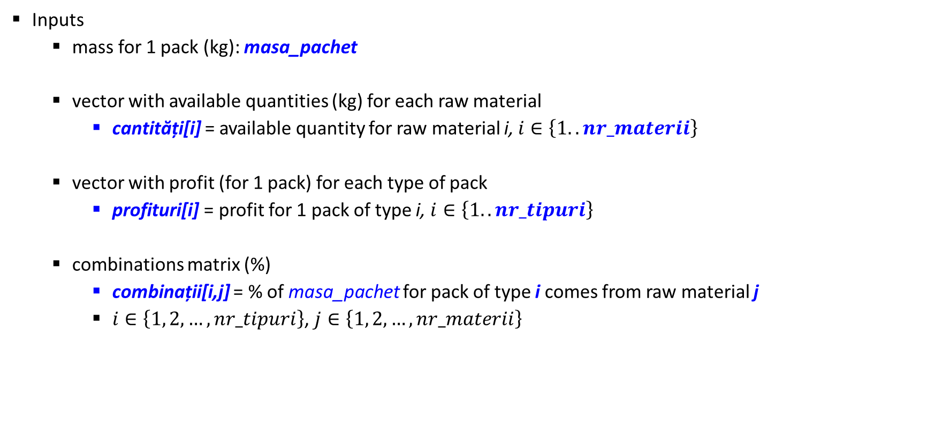
GA solution
Inputs
mass for 1 pack (kg): masa_pachet
vector with available quantities (kg) for each raw material
cantități[i] = available quantity for raw material i, $i∈\left\{1..nr_materii\right\}$
vector with profit (for 1 pack) for each type of pack
profituri[i] = profit for 1 pack of type i, $i∈\left\{1..nr_tipuri\right\}$
combinations matrix (%)
combinații[i,j] = % of masa_pachet for pack of type i comes from raw material j
$i∈\left\{1, 2, …,nr_tipuri\right\}$, $j∈\left\{1, 2, …, nr_materii\right\}$

Slide 3
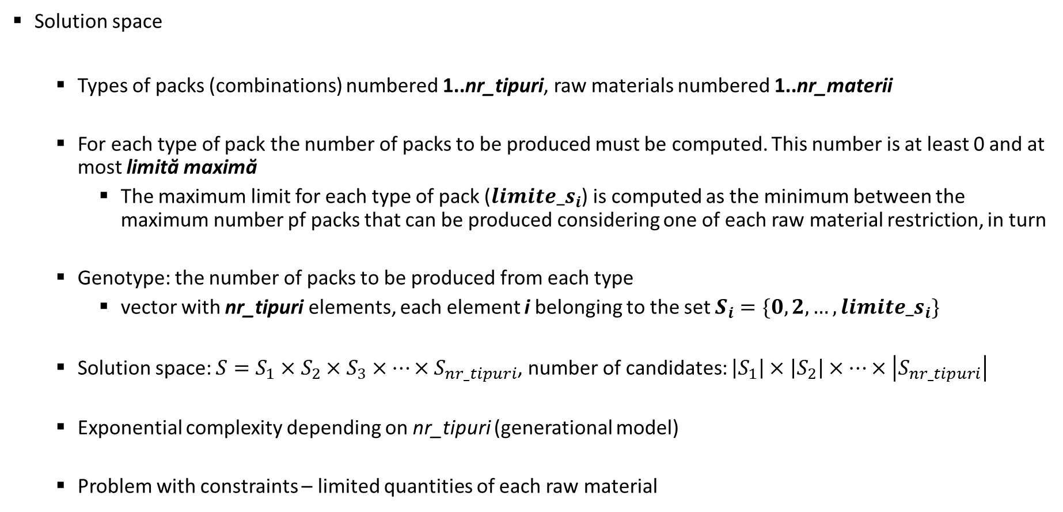
GA solution
Solution space
Types of packs (combinations) numbered 1..nr_tipuri, raw materials numbered 1..nr_materii
For each type of pack the number of packs to be produced must be computed. This number is at least 0 and at most limită maximă
The maximum limit for each type of pack (${limite_s}_{i}$) is computed as the minimum between the maximum number pf packs that can be produced considering one of each raw material restriction, in turn
Genotype: the number of packs to be produced from each type
vector with nr_tipuri elements, each element i belonging to the set $S_{i}=\{0, 2,…,{limite_s}_{i}\}$
Solution space: ${S=S}_{1}×S_{2}×S_{3}×…×S_{nr_tipuri}$, number of candidates: $\left|S_{1}\right|×\left|S_{2}\right|×…×\left|S_{nr_tipuri}\right|$
Exponential complexity depending on nr_tipuri (generational model)
Problem with constraints – limited quantities of each raw material

Slide 4
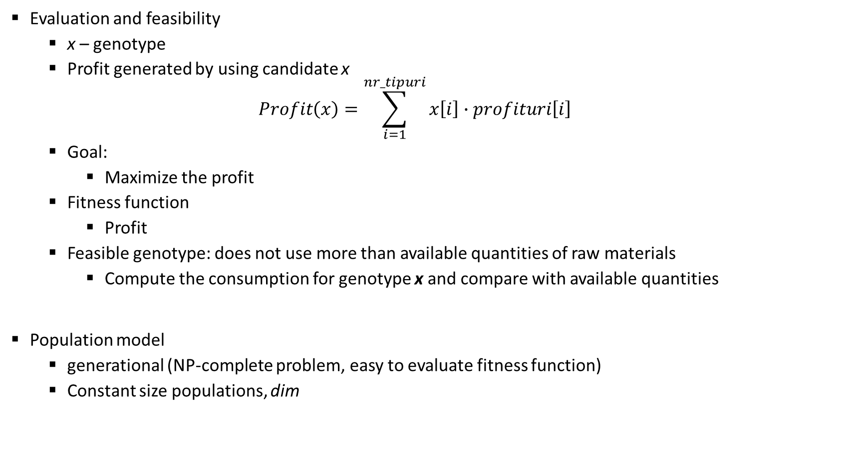
GA solution
Evaluation and feasibility
x – genotype
Profit generated by using candidate x
$$Profit\left(x\right)=\sum_{i=1}^{nr_tipuri}{x\left[i\right]∙profituri\left[i\right]}$$
Goal:
Maximize the profit
Fitness function
Profit
Feasible genotype: does not use more than available quantities of raw materials
Compute the consumption for genotype x and compare with available quantities
Population model
generational (NP-complete problem, easy to evaluate fitness function)
Constant size populations, dim

Slide 5
GA solution
Generation of initial population
Random, uniform in the search space, with verification of feasibility and evaluation
Unfeasible individuals are discarded and new ones are generated
Parent selection
Generational model: from dim candidates in the current population, dim parents are selected
Fitness function has strictly positive values ⇨ SUS mechanism with FPS with sigma scaling
Selection of next generation
Elitism

Slide 6
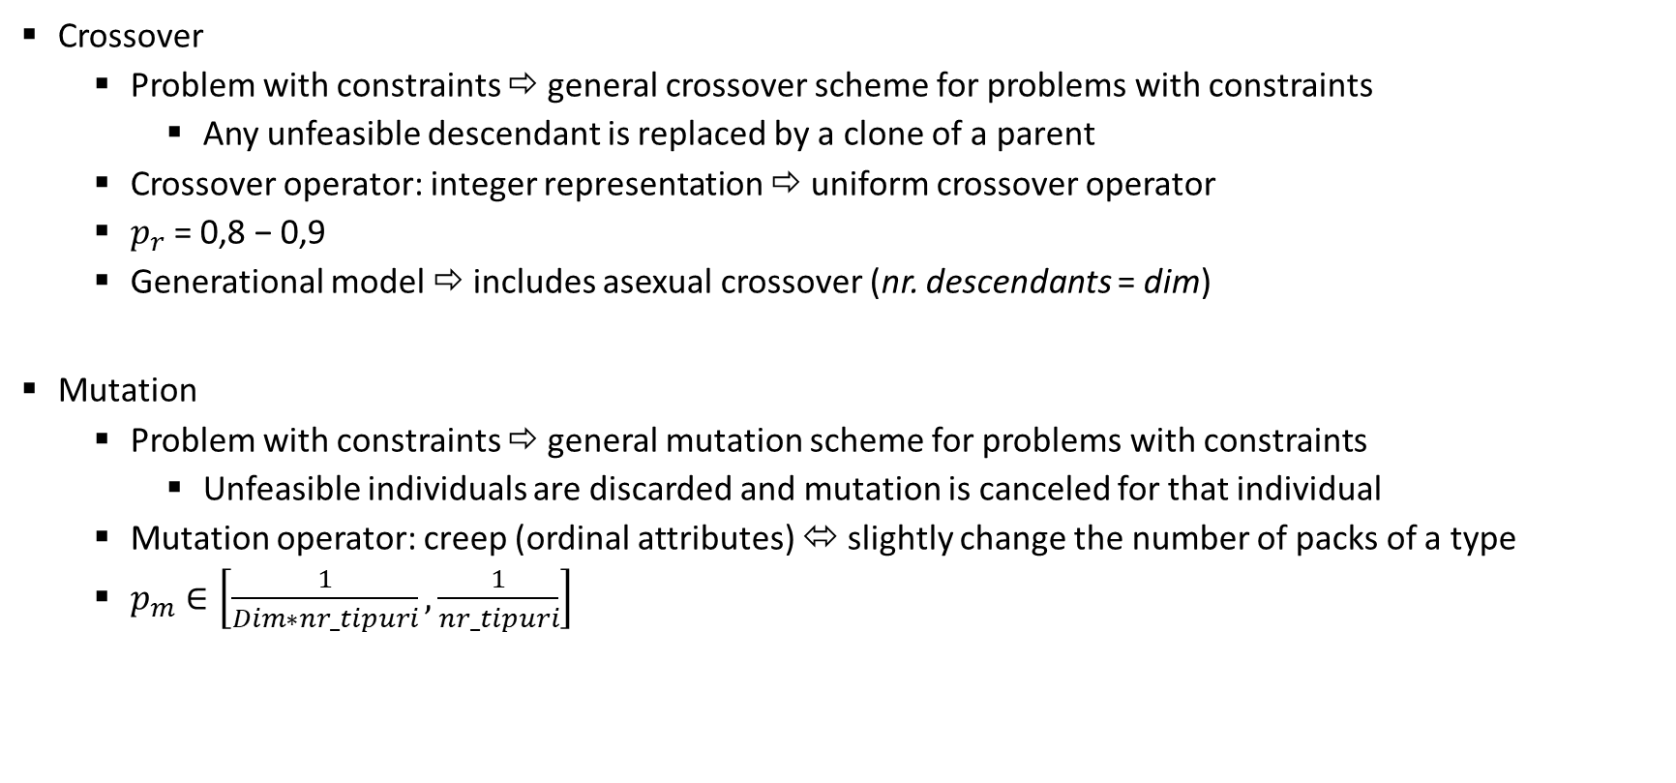
GA solution
Crossover
Problem with constraints ⇨ general crossover scheme for problems with constraints
Any unfeasible descendant is replaced by a clone of a parent
Crossover operator: integer representation ⇨ uniform crossover operator
$p_{r}$ = 0,8 − 0,9
Generational model ⇨ includes asexual crossover (nr. descendants = dim)
Mutation
Problem with constraints ⇨ general mutation scheme for problems with constraints
Unfeasible individuals are discarded and mutation is canceled for that individual
Mutation operator: creep (ordinal attributes) ⬄ slightly change the number of packs of a type
$p_{m}∈\left[\frac{1}{Dim∗nr_tipuri},\frac{1}{nr_tipuri}\right]$

Slide 7

GA solution
Stop condition
Maximum number of iterations
All candidates in current population have the same fitness
During the last $k=nmax/3$ generations the maximum quality was not improved
Result
The best individual from the last generation

